Slide 1



Information Assurance and Cyber Security at Norfolk State University
Sandra J. DeLoatch, Massie Chair
Dean, College of Science, Engineering, and Technology
Annual MSI Technical Meeting
  November 10, 2010

Slide 2
Overview
Background
NSU as NSA/DHS CAE/IAE
Specific DOE Initiatives

Slide 3
NSA/DHS Center of Academic Excellence
NSA and the Department of Homeland Security (DHS) jointly sponsor the National Centers of Academic Excellence in IA Education (CAE/IAE) and CAE-Research (CAE-R) programs
The goal of these programs is to reduce vulnerability in our national information infrastructure by promoting higher education and research in Information Assurance (IA) and producing a growing number of professionals with IA expertise in various disciplines
Designation as a CAE/IAE or CAE-R is valid for five academic years, after which the school must successfully reapply in order to retain its CAE designation

Slide 4
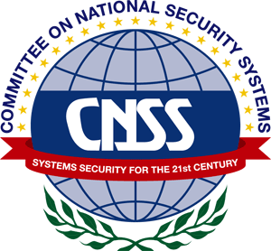
NSA/DHS Center of Academic Excellence (CAE) in Information Assurance (2009-2014)
Designation was awarded to NSU in June 2009
NSU is the 4th Virginia University to received this distinction (of 106 total)
Requires that Information Assurance courseware be certified under the IA Courseware Evaluation Program as meeting the Committee on National Security Systems (CNSS) Training Standards

Slide 5
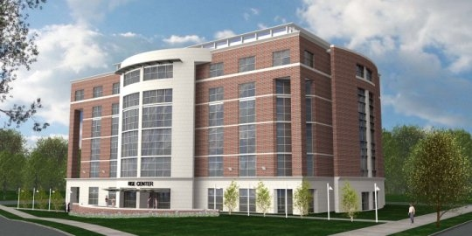
McDemmond Center for Applied Research
Houses the following units:
  Center for Material Research (CMR)
  Creative Gaming and Simulation (CGS) Lab
  Information Assurance Research, Education, and Development Institute
  Engineering and Computer Science Graduate Research
State-of-the-art class 100 clean room
Numerous research labs

Slide 6
NSU IA Academic Programs
B.S. and M.S. Degrees in Computer Science - Specialty in Information Assurance
Two Information Assurance Certificate Programs based on CNSS Training Standards 4011 and 4012 that prepare students for a variety of positions including:
  Computer Network Defense Analysts
  Computer Network Defense Infrastructure Support Service Providers
  Information Assurance Technician
  Information Assurance Manager
  Computer Network Defense Incident Responder
  Computer Network Defense Auditor
  Computer Network Defense Manager

Slide 7
IA and Cyber Security Project¹
Program Goals
Advance the discipline of Information Assurance through research that will focus on wireless security in a classified environment and securing cloud computing
Address the demands for trained information assurance professionals
¹Funded by the Department of Energy, Award # DE-FG52-09NA29516

Slide 8
Specific Initiatives
Develop and expand curricula designed to train students for specific categories within National Nuclear Security Administration (NNSA) cyber security
Progress
Four faculty members attended Cyber Security Training at Carnegie Mellon University in July 2010.
Two faculty members attended conferences on Cloud Computing.
Two graduate certificates (Information Assurance Systems Manager and Information Systems Security Professional) were developed.
Training material from the Security + and CISSP certifications are being incorporated into a newly developed course, Management of Information Security
One faculty member will be attending CISSP certification training in December, 2010.

Slide 9
Specific Initiatives (continued)
Increase the cadre of trained IA professionals by targeting groups in Southern Virginia such as transitioning military personnel, transfer students from computer security technology in regional community colleges, DoD, and high school students
Progress
Met with the Dean at Tidewater Community College (TCC) to discuss transfer agreement and to establish a “feeder” program for NSU’s CS Program in IA
Made several recruiting trips to college recruiting fairs
Conducting outreach at Virginia Beach and Suffolk middle schools

Slide 10
Specific Initiatives (continued)
Expand the university’s mentorship of other minority institutions to help them to contribute to the efforts of cyber defense
Progress
Collaborated with Virginia State University, Mississippi Valley State University and Tougaloo College to assist with IA curriculum development.
Provided training to faculty from Mississippi Valley State University on incorporating IA material across the curriculum
Preparing a joint cyber capacity building proposal with Polytechnic University of Puerto Rico.

Slide 11
Specific Initiatives (continued)
Increase the state-of-the-art of cyber security in the United States through a series of well-defined research initiatives
Progress
The two well-defined research initiatives underway are:
  Wireless Security in a Classified Environment
  Securing Cloud Computing

Slide 12
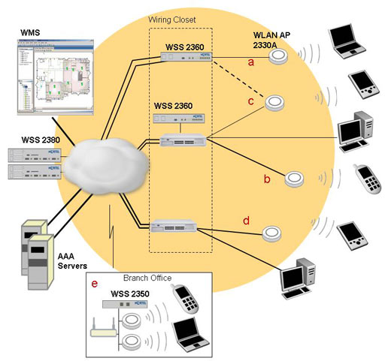
Wireless Security in a Classified Environment
Classified Wireless Local Area networks (WLAN) carry classified information
They are to employ NSA encryption, an encryption key commensurate with the classification level, and have IA measures consistent with the Committee on National Security Systems (CNSS) Policy No. 17

Slide 13
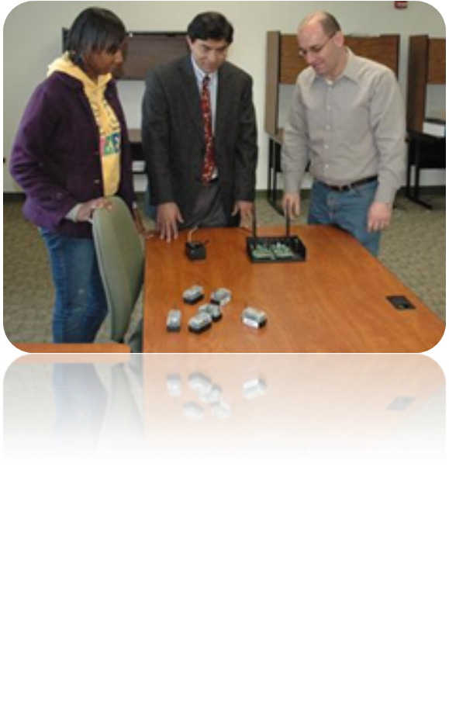
Wireless Security in a Classified Environment
Goal
  Translate the Internet Protocol Security (IPSEC) to lower layers, covering WLANs for a seamless and secure integration of IEEE 802.11-based WLANs with secure Internet

Slide 14
Wireless Security in a Classified Environment Accomplishments
A detailed report has been prepared on the operation of IPsec and WLAN security (based on CCMP) and how each thwarts various attacks and those for which vulnerabilities still exist.
Another report on the use of R-BAC for WLAN has been prepared. Our analysis shows that multi-level R-BAC would be suitable for use in a wireless classified environment.
The role-based access control (R-BAC) has been identified as a potential solution for classified access control for WLANs.
Algorithms have been developed to identify misbehaving nodes in wireless sensor networks.

Slide 15
Wireless Security in a Classified Environment Accomplishments (continued)
Prepared a white paper as a visionary security and forensic solution for wireless LANs. The paper proposes the use of a security system that not only keeps track of the WLANs users’ location but triggers a secure forensic alarm in case of attempts detected on the system vulnerabilities.
Began establishing a test bed for launching attacks and studying their impact.
Completed the study of security provided by the IEEE 802.11 standard; currently identifying which attacks can be thwarted in order to identify weaknesses in the protocol.

Slide 16
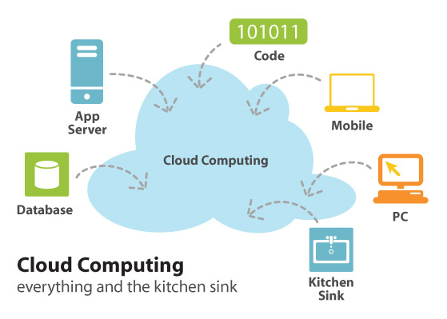
Cloud Computing
Cloud computing is a general term describing the delivery and consumption of IT services over the Internet. The services are categorized as:
Infrastructure-as-a-Service: Clients are
provided virtual servers which they
configure for their particular needs
  Platform-as-a-service: Clients use software tools on the provider’s hardware to develop their applications
  Software-as-a-service: Clients are provided with both the hardware and software applications and interact with the user through a front end

Slide 17
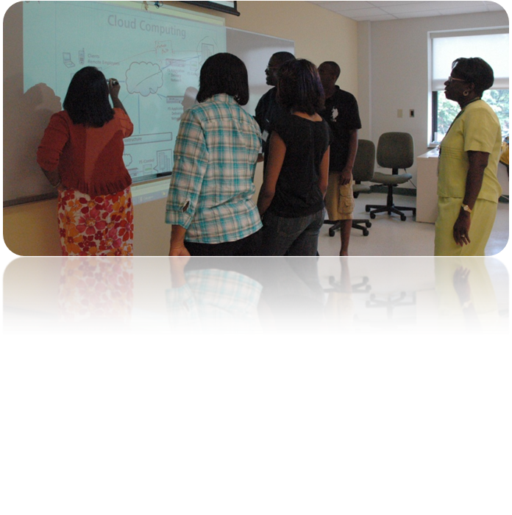
Securing Cloud Computing
Goal
Development of security policies for Cloud Computing and the framework which permits auditing and forensic analysis across the Computing Cloud

Slide 18
Securing Cloud Computing
Major Accomplishments
Graduate Students
Completed a M.S. Thesis, entitled “Integrating XKMS into a Secure Embedded Fine-Grained Access Control Framework”, in July 2010. This thesis research was focused on key management and access control mechanisms.
Completed the high-level design for the Java Identity-Based Cryptography (IBE) Library, based on the open-source jPBC (Java Pairing Based Cryptography) Library.
Completed the initial installation and configuration of the forensics testbed involving two identical data servers, one in a private cloud (based on VMware vSphere platform) and the other used for physical acquisition locally.

Slide 19
Securing Cloud Computing
Major Accomplishments
Graduate Students (continued)
Determined the data storage pattern of fingerprint data on Apple Macintosh Mobile Devices.
Initiated a research project to develop a prototype for a secure Electronic Medical Record system for cloud computing, using VMware cloud infrastructure and developing cloud applications.
Initiated a research project to investigate security and virtualization to identify additional metadata that may be needed to determine the trustworthy state of a virtual machine at an instance of time.
Initiated a research project to investigate secure virtual networking for cloud computing infrastructures and applications.

Slide 20
Securing Cloud Computing Accomplishments (continued)
Faculty
Completed the research and development of the practices and procedures for performing a forensics investigation of a USB drive using Access Data’s Forensics Toolkit (FTK) through a physical acquisition.
Built and experimented with a small private cloud using the open-source Ubuntu Private Cloud software.
Experimented with Microsoft’s Azure Cloud Computing platform and explored how to develop Web 2.0 applications on such platform.

Slide 21
Securing Cloud Computing Accomplishments (continued)
Faculty
Experimented with data acquisition of Apple based mobile devices using FTK forensics software.
Started the first phase of lab setup with 10 workstations and 2 servers, and installing VMware virtualization platforms and solutions (VMware vSphere and VMware vCenter).

Slide 22


Additional Information
Sandra J. DeLoatch, Dean
College of Science, Engineering, and Technology
E-mail: sjdeloatch@nsu.edu
Telephone: (757) 823-8180
Facsimile: (757) 823-9114
Web: www.nsu.edu
cset.nsu.edu

